Slide 1
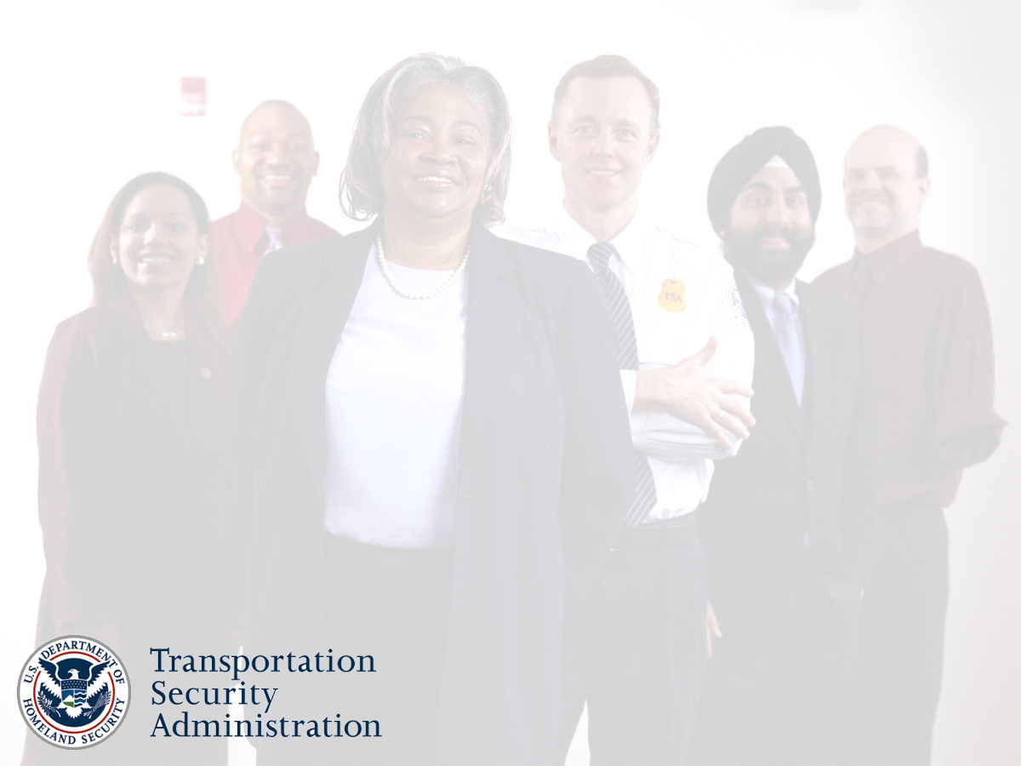
Office of Civil Rights and Liberties
Transportation Security Administration
“Excellence Through Diversity and Service”
Kimberly Bandy, TSA Federal Women’s Program Mgr
October 2010

Slide 2
Objectives
Review of DHS and the Transportation Security Administration Mission and responsibilities
Review of FEW and FWP program
Review of TSA FWP Program highlights
Review of Resources
Contact information

Slide 3
SNAPSHOT: TSA

Slide 4
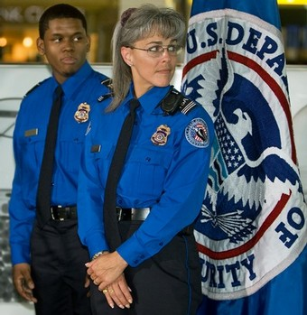
Background
The ATSA was signed into law in November, 2001 requiring the deployment of Screeners and FAMs as the Federal law enforcement presence to secure and protect the aviation domain.
We are 65,000 security officers, inspectors, directors, air marshals and managers who protect the nation's transportation systems We look for bombs at checkpoints in airports, we inspect rail cars, we patrol subways with our law enforcement partners, and we work to make all modes of transportation safe.

Slide 5
Office of Civil Rights and Liberties
The Transportation Security Administration's Office of Civil Rights and Liberties aims to ensure that all employees and the public are treated in a fair and lawful manner without regard to race, color, national origin, religion, age, gender, disability, sexual orientation, parental status, or genetic information.
With TSA's “zero tolerance” for harassment, illegal discrimination, and retaliation, our office helps the agency recognize and respect the social and cultural backgrounds of our staff and customers. These efforts ultimately improve our nation's security.

Slide 6
DMOD - Primary Role and Services
Provide EEO operation services directly to TSA field components designed to:
Promote the TSA strategic goal of achieving a diverse
workforce through special emphasis programs, outreach
projects and partnering activities.
Provide advice, training and technical guidance to field
component operations, FAMS, and HQ officials on
Federal EEO laws and policy.
Support management’s role and responsibility for resolving
EEO and civil rights matters concerning allegations of
unlawful discrimination and harassment through training,
coaching, and on-line information/tool-kit.
Notes:
The Regional Operations Support and EEO Division provides leadership on affirmative employment policy, EEO training and compliance; and special emphasis programs for TSA. The Division collaborates with various TSA staff offices on the preparation of TSA annual civil rights activity reports for the White House Initiatives Offices, DHS OCRL, OPM and EEOC. This is the pro-active team in OCRL that work with all levels of management at TSA in support of diversity initiatives, outreach and equal employment opportunity activities impacting all TSA programs, services.
RSO&EEO primarily supports management initiatives and activities to enhance equal employment opportunity in TSA. The Division does not process EEO complaints.

Slide 7
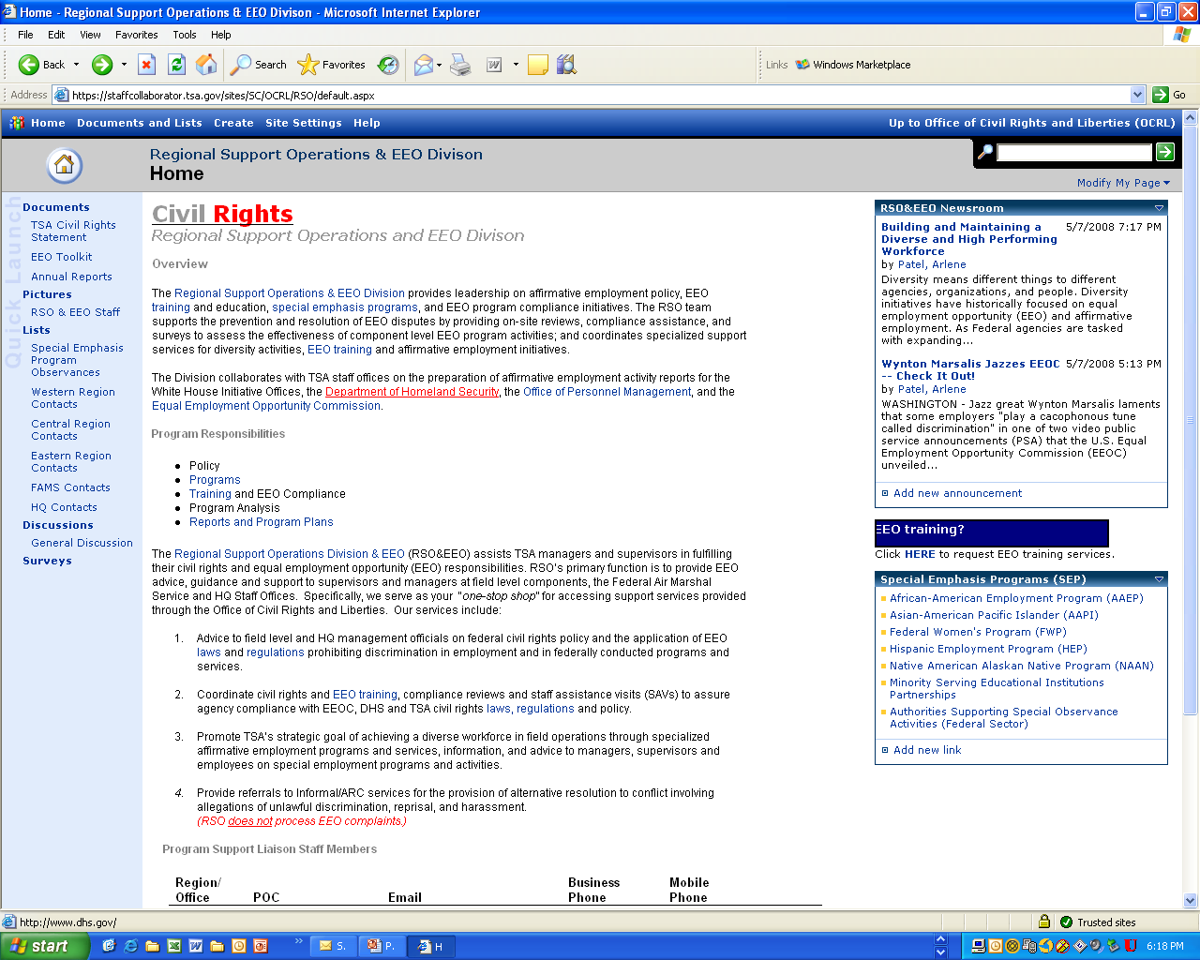
Office of Civil Rights & Liberties

Slide 8
Research
Women are greatly outnumbered by men in federal law enforcement careers (Reaves & Bauer, 2003).
  Women accounted for just 14.8% of sworn federal law enforcement officers in 2002 and 16.1% in 2004 (Reaves & Bauer, 2003; Reaves, 2006).
  Women comprise 5% of the FAMs workforce
The majority of research focuses on state and local police -- very little research has been conducted on women in federal law enforcement.

Slide 9
Federal Women Program
Focus and Goals

Slide 10
FWP Program
Three-Fold Mission Focus
Promote and Publicize your designation as the FWPM; Serve as a liaison between staff employees and management; and represent program not individuals; Market your Program
Workforce (agency leadership, other FWPMs, other federal agencies, non-profit organizations; universities, schools
Provide Information on the employment status of women in your agency; Identify and address employment barriers; become expert on matters that relate to women in your workplace .
Employees, Leadership, OPM, EEOC, WHCWG
Review Resources and Skills Review Regulations, policies, procedures, advisory committees, other FWP managers, FEW,
Employees, Leadership, OPM, EEOC, WHCWG
.

Slide 11
Resource Allocation Plan
Purpose: Step by step procedure for SEP plan, which identifies program needs
Ensures a results oriented program as recommend by OPM
Components
  Work Plan (Assessment Report of estimated time and resources to implement planned actions during FY)
  Budget Sheet (Review Statistics, establish priorities, and obtain approval)

Slide 12
ACCOUNTABILITY
MD-715 – EEOC -- The MD-715 is government-initiated and mandated; it is compliance-based and relies on statistical comparisons of various demographic group; contain goals and timetables designed to bring the level of participation for minorities, women, and persons wit disabilities in to parity with relevant and available labor force applicant pool; and reflects Fiscal Year progress made to mitigate and/or eliminate barriers that impede employment opportunities for minorities, women, and persons with disabilities.
White House Council on Women and Girls
Agency Leadership
OPM – FEORP -- Federal Equal Opportunity Recruitment OPM has the responsibility to annually report to Congress on progress under the Federal Equal Opportunity Recruitment Program (FEORP). The report is prepared in compliance with the law (5 U.S.C. 7201 and 5 CFR Part 720, Subpart B) and contains information on the representation of minorities within the Federal Government and best practices of Federal agencies. OPM is committed to, and is taking aggressive action to ensure, diversity in the Federal Government.

Slide 13
SNAPSHOT: TSA FWP Program Highlights

Slide 14
General Health of TSA
As Reflected in MD-715 Report
Demonstrated Commitment agency leadership
All managers and supervisors are not held accountable for diversity/ inclusive workplace
Integration of EEO into Mission
Inconsistent OCRL involvement in recruitment, outreach efforts, and review for disparate impact on minorities, women and PWDs of proposed plans and policies
Management/Program Accountability
Senior OHC and OCRL leadership meet infrequently to assess personnel programs, policies and procedures impacting TSA
workforce
Notes:
Table A3-1, pg 55, MD 715
Table A4-2, pg 57, MD 715
Table A8, pg 61, MD 715
Table A13, pg 65, MD 715
Table B2, pg 71, MD 715

Slide 15
General Health of TSA
FY08 MD-715 Report
Prevention
Senior Managers infrequently consult with Director, OCRL to identify barriers that may impede diversity and EEO
Efficiency
Insufficient resources to conduct effective audits of field facilities i.e., barrier identification and elimination
EEO/Legal Compliance
TSA agency head/designee certifies annual EEOC MD-715 Report. TSA complies with EEOC AJ orders/instructions within timeframes.
Notes:
Table A3-1, pg 55, MD 715
Table A4-2, pg 57, MD 715
Table A8, pg 61, MD 715
Table A13, pg 65, MD 715
Table B2, pg 71, MD 715

Slide 16
Successful FWP and TSA FWP Program
  FWP PROGRAM
Outreach
Retention
Career Development
Awareness
Training
Indentifying and Eliminating Barriers
Eliminating Harassment and discrimination
  TSA PROGRAM
  Statutory Authority
  Collateral duty/Balancing Act
  TSA Working Group
  IShare Page/Education
    Articles
    Job announcements
    Personal Achievements
    Conferences
    Grants & Scholarships
  Brown Bag Seminars

Slide 17
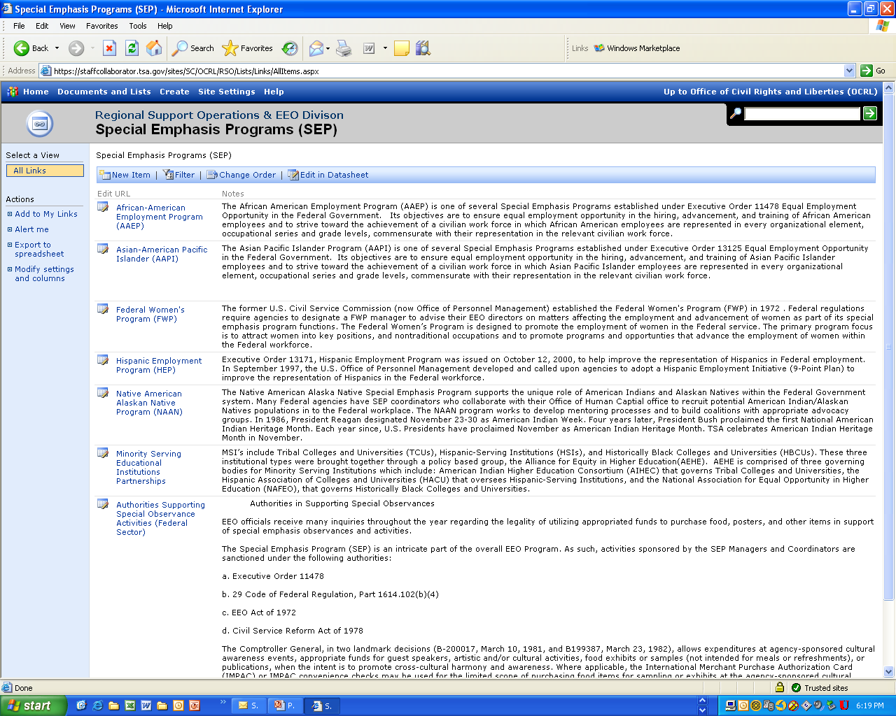
Office of Civil Rights & Liberties

Slide 18
Successful FWP and TSA FWP Program
Next Steps….
  FWP PROGRAM
Outreach
Retention
Career Development
Awareness
Training
Indentifying and Eliminating Barriers
Eliminating Harassment and discrimination
  TSA PROGRAM
Recruitment
  Partner with Human Capital
  OnBoarding
Retention
  Mentoring
  Exit Interviews
Outreach
  Partner with HR
  Work with Non-profits
Barrier Analysis
  Work with HR and management to break down and eliminate barriers

Slide 19
Resources
FWPM Managers

Slide 20
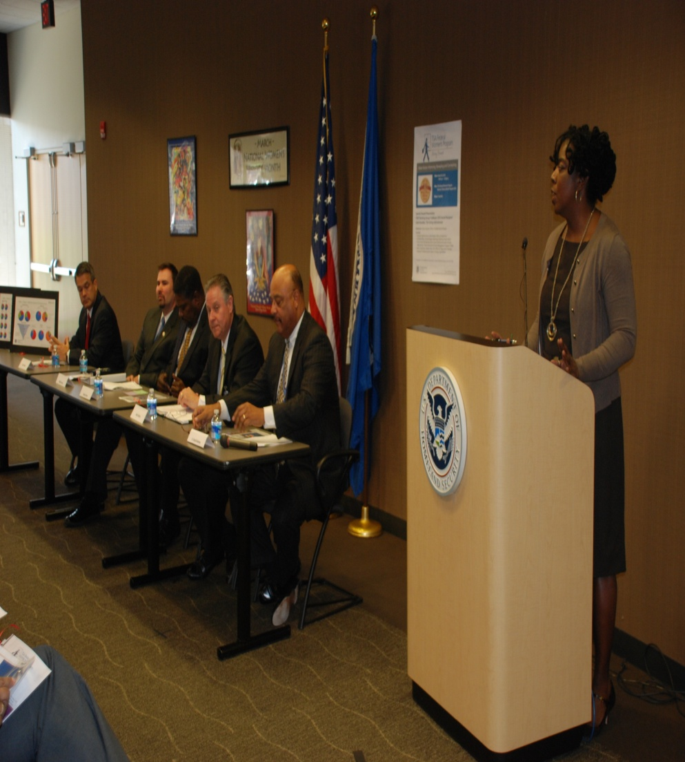
Other FWPMS: and other Federal agencies
  Share information
  Share Best Practices
  Share resources
  Partner on Events
  Learn from each other

Slide 21
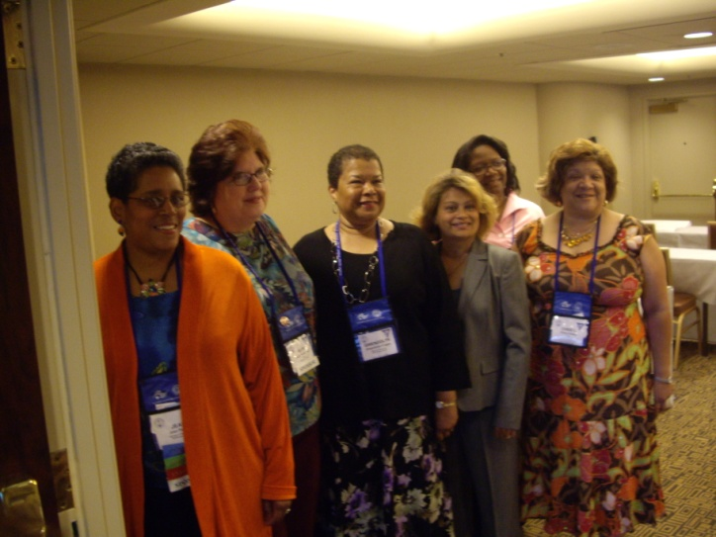
Resources: National Council of Federal Women Program Managers
  Developed out a need to share information and resources in order to develop more effective viable programs.
  Comprised of FWP mangers from the DC Metro area
  Meets monthly
  Main Goal to ensure all FWPMs receive the training and information they need to successfully mange their programs

Slide 22
RESOURCES: Other Entities
DEOMI -- Defense Equal Opportunity Management Institute www.deomi.org/ - training for SEPM coordinators
Rushford and Associates – SEPM Training www.rushfordtraining.com
EEOC for information on MD-715 and FWP – www.eeoc.gov
White House Council on Women and Girls - http://www.whitehouse.gov/administration/eop/cwg

Slide 23
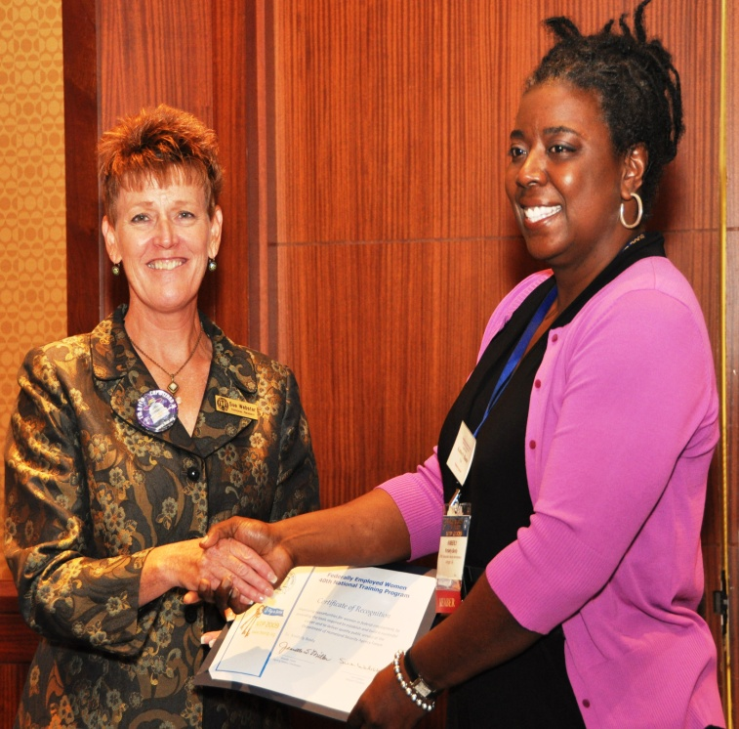

RESOURCES: FEW
Benefits of FEW Membership
FWP TASK FORCE
Few NTP
  Workshops
  Agency forums
www.few.org

Slide 24


CONTACT INFO
TSA FWP PROGRAM MANAGER
Kimberly Bandy
Office: 571-227-2352
Cell: 202-306-0293
Kimberly.Bandy@dhs.gov

